Slide 1
Leverage AI In Product Management
How AI Technologies Can Improve Productivity of Daily PM Activities

Slide 2
How I Got Started with the Project
My prompt to Claude Code:
I am going to create a 1-hour long presentation to share with my team on how to use AI to improve productivity in Product Management roles. Our daily work involves creating product presentations and marketing collaterals (blogs, videos etc), making product & packaging analysis and decisions, analyzing business data, meeting with internal teams and external customers. I would like to have you give me a plan on the content I should include in my presentation. I would also like you to point out AI tools I should explore to see if they can help with the tasks we have daily. Rank the tools you recommend and provide web link.

Slide 3
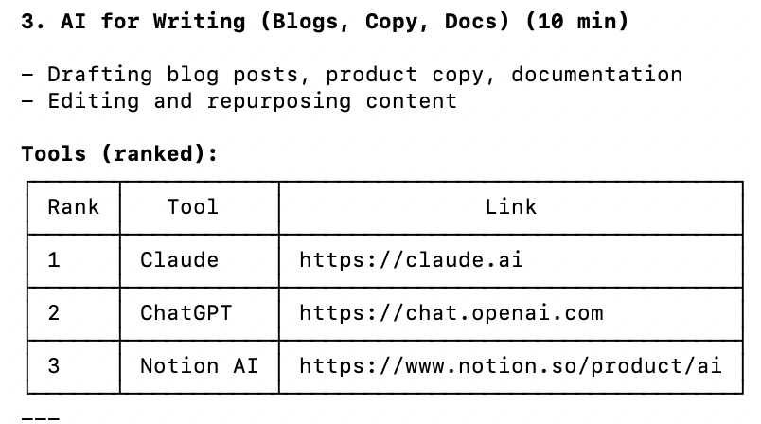
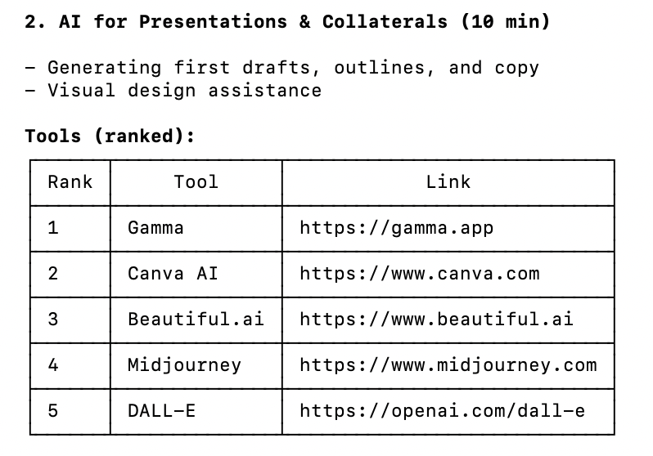
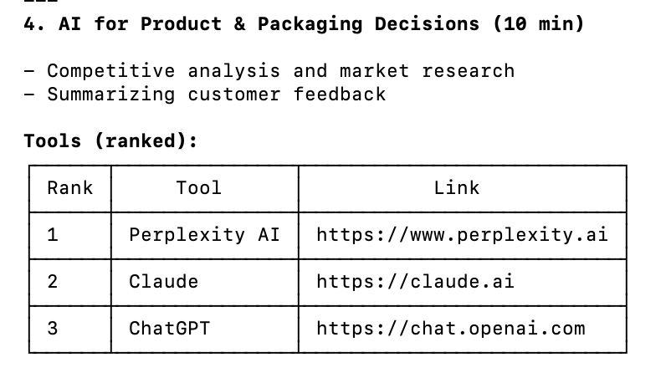

Slide 4
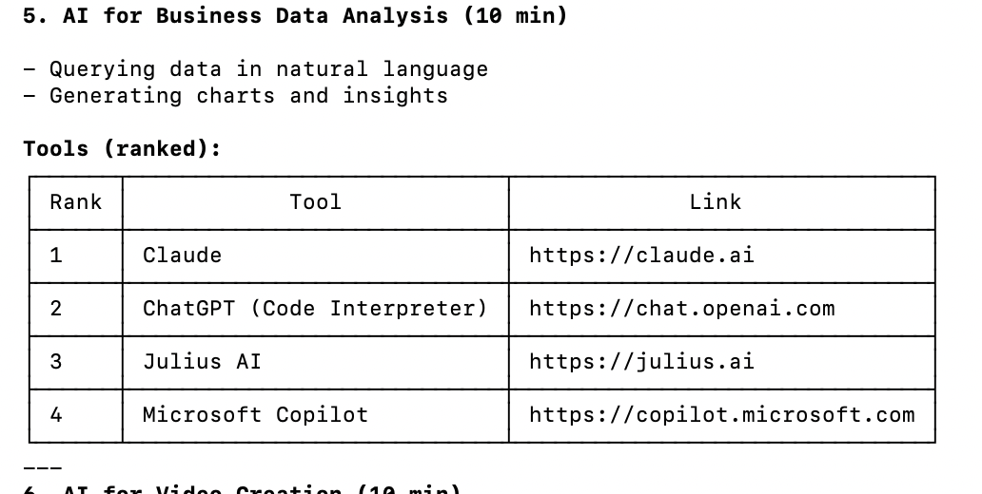
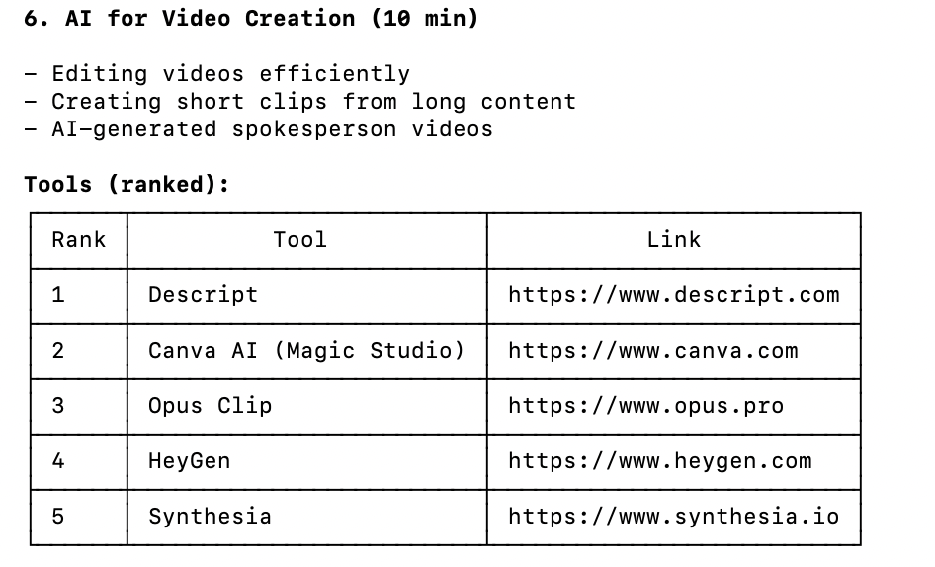
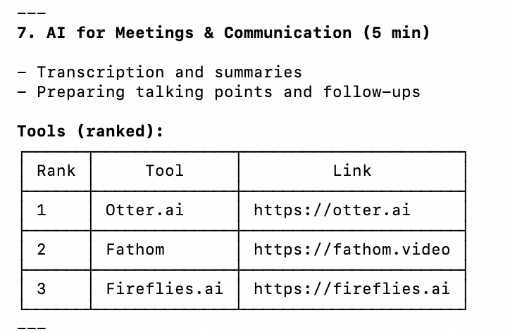

Slide 5
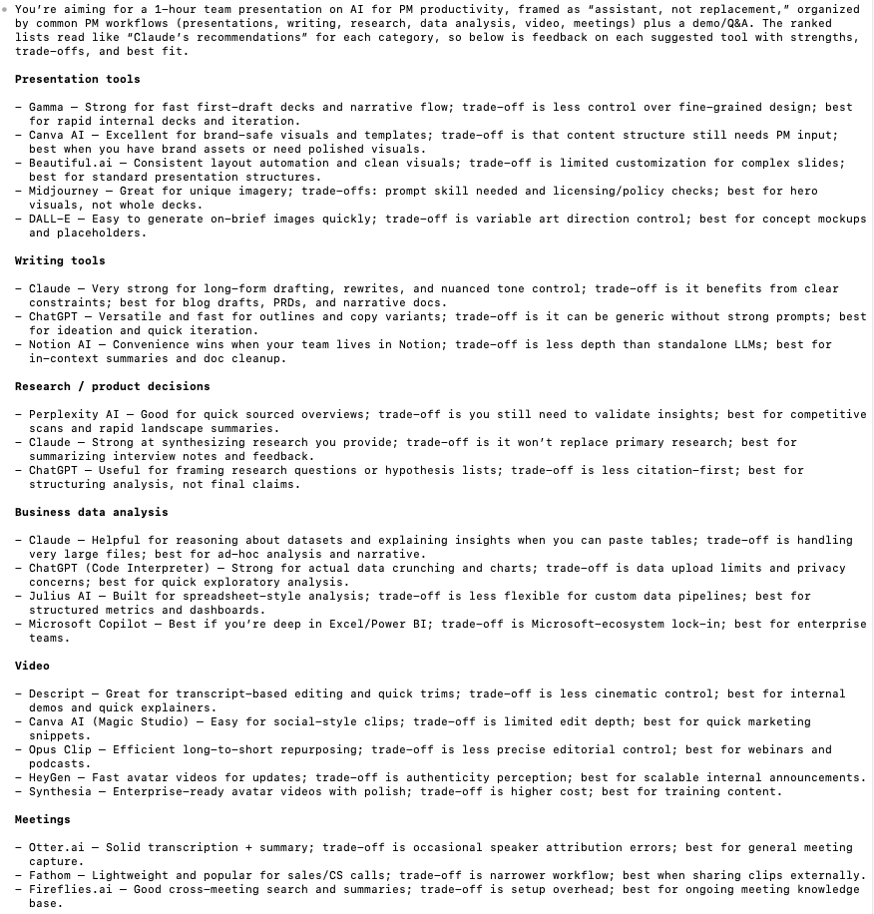
Then I asked Codex to Provide Feedback
As usual, Codex is very thorough…
So I asked Codex to interview me to create a customized list…

